Slide 1

START
P = Principle
R = Rate
T = Time
$$A=P\left(1+(\frac{R}{100})T\right)$$
STOP

Slide 2
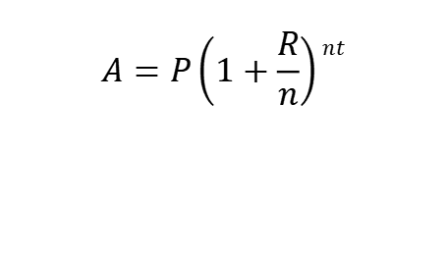
START
P = Principle
R = Rate
T = Time
N = Number of compounded interst
$$A=P\left(1+\frac{R}{n}\right)nt$$
$$A=P\left(1+\frac{R}{n}\right)nt$$
STOP

Slide 3

START
P = Principle
R = Rate
T = Time
N = Number of compounded interst
PMT = Yearly Payment
$$A=PMT x\frac{\left[\left(1+\frac{R}{n}\right)nt −1\right]}{(\frac{R}{n})}$$
$$A=P\left(1+(\frac{R}{100})T\right)$$
STOP

